Slide 1
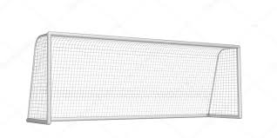

Predicting the 1. Bundesliga
Advanced Data Science with IBM - capstone project, Coursera
By Florian Parche

Slide 2

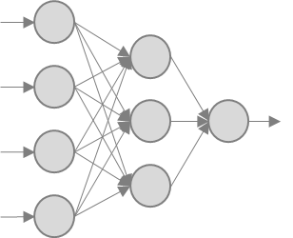

Overview
Idea:
Predict the outcome¹ of 1. Bundesliga games
How?
Machine Learning
Neural Network
Decision Tree
Suppor Vector Machine
Goal:
Outperform ‘naive’ picks
The favorite
The home team
Use case:
Beat your friends & colleagues
?
Defined as: Home team win – Draw – Away team win

Slide 3
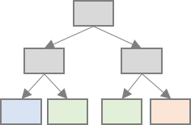

Result
Accuracy:
Neural Network: 53.52%
Favorite: 53.17%
Home Team: 49.47%
0.35%
The model barely and insignificantly outperforms ‘naive’ approaches

Slide 4
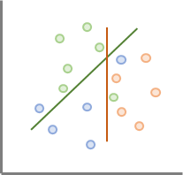
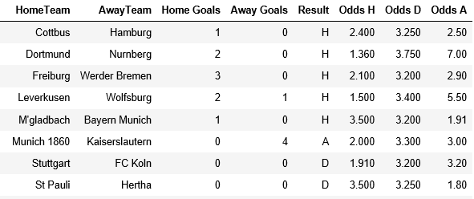
Data
Dataset¹:
3,780 Games
28 Teams²
Aug 2001 – May 2018
Inputs:
Outcome Odds³
Feature Engineering
Past goals scored
Past goals scored against
Past points per game
Ranks of the above (among all teams)
Exclusions:
Games with either team not in the league in the previous season
Cleaned data prior to feature engineering
Data source: www.football-data.co.uk/germanym
Note that there are 18 Teams in the league in any given season
Odds are the median from three providers that are available in every season in the dataset

Slide 5
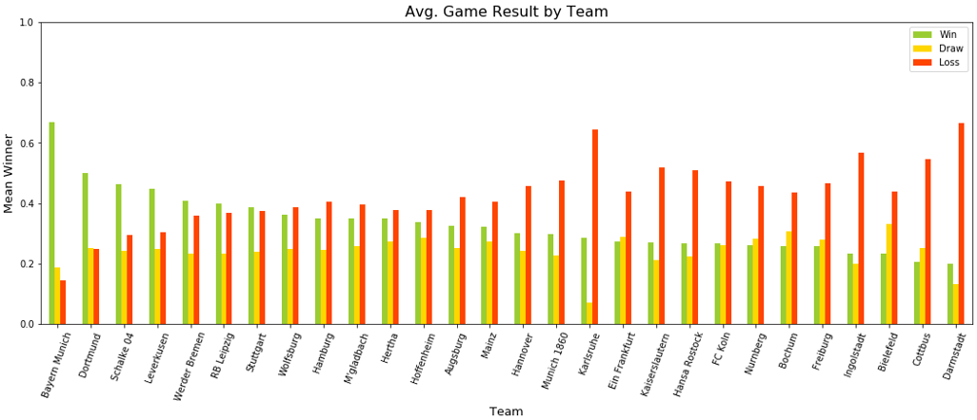
Historical Winners
7 Teams: W > L
21 Teams: W < L

Slide 6
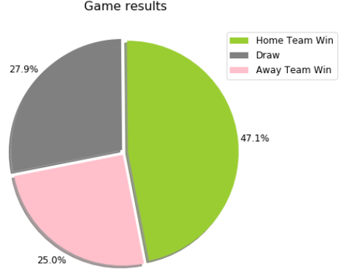
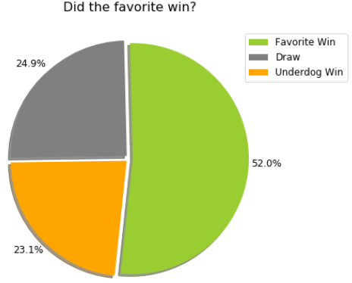
Historical Tendencies
The home team tends to win
The favorite tends to win

Slide 7
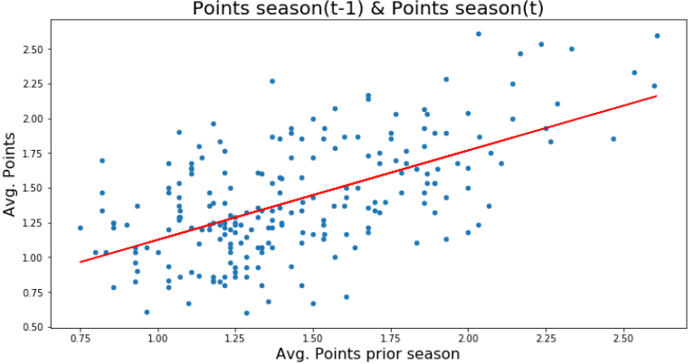
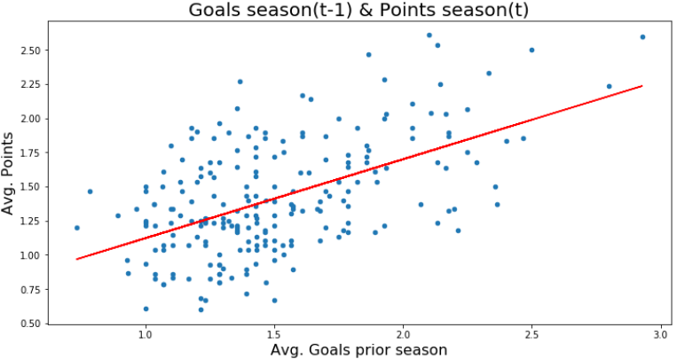
Predictability
Eyeball-Econometrics: There is some predictability

Slide 8
Feature Engineering
General:
Prev. Season:
Total goals scored (H & A)
Total goals scored against (H & A)
Points at season end
Home Team:
Goals scored when at home
Goals scored against when at home
H, D, A odds
Away Team:
Goals scored when away
Goals scored against when away
H, D, A odds
47 Features in total
Prev. season's statistics
Avg. statistics prev. n games
Avg. statistics prev. m games ranked among all teams

Slide 9
Hyperparameters
General
Neural Network
Weight of prev. season‘s statistics
No. of prev. games for averages
No. of prev. games for ranks
Scaler¹
No. nodes in dense layer²
Dropout rate²
Activation function³
Optimizer⁴
Epochs & Batchsize
Decision Tree
SVM
Max tree depth
Kernel⁵
If Polynomial - degree
MinMax, StandardScaler or [-1, 1]
The layers of the NN include 4 dense layers and 2 dropout layers
Relu, leaky Relu or Tanh
Adam, Adadelta, Adagrad or SGD
Linear, Polynomial or Gaussian

Slide 10
Model results
Datasplit:
75% Training – 10% Validation – 15% Testing
Model | Accuracy
Neural Network | 53.52%
Decision Tree | 50.53%
SVM | 52.46%
Democracy | 55.52%
Unanimous¹ | 60.34%
Favorite | 53.17%
Home Team | 49.47%
‘Unanimous’ is significantly more accurate (5% level of better), except ‘Democracy’
‘Democracy’ is significantly more accurate than ‘Tree’ (10% level) and ‘Home Team’ (5%)
‘Neural Network’ is not significantly more accurate than any other approach
Picks: 353 out of 567 (~62%)

Slide 11
Model details
Hyperparameters:
Weight of prev. Season: 100%
No. prev. Games for Avgs.: 15
No. prev. Games for Ranks: 15
Scaler: StandardScaler
Optimizer: Adam
Epochs: 40
Batchsize: 32
47 Features
47 Neurons
Dense layer
0.3 Dropout
Relu
30 Neurons
Dense layer
0.15 Dropout
Relu
10 Neurons
Dense layer
Relu
Dense layer
Softmax
H – D – A

Slide 12
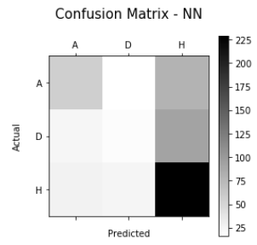
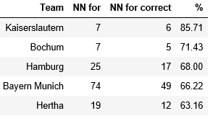
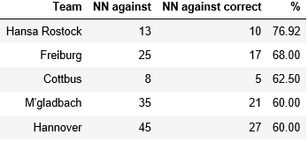
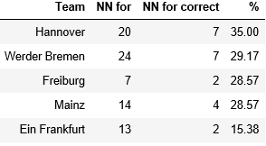
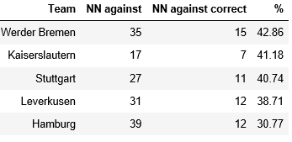
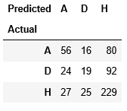
Evaluation – Neural Network
Test set: 567 Games – Accuracy: 53.52%
Confusion Matrix
NN predicts Win¹
NN predicts not-Win¹
Filtered for 5 or more win / not-win predictions

Slide 13
Strategy evaluation
Strategy:
Combine model prediction & teams that were accurately predicted in the training set
Most accurate n teams picked to win, m teams picked to not-win
No. Teams included for which # Picks * (Accuracy ** 2) is maximized in the validation set
Model | Accuracy | Strategy¹
Neural Network | 53.52% | 55.0% (340)
Decision Tree | 50.53% | 52.2% (389)
SVM | 52.46% | 51.6% (401)
Democracy | 55.52% | 54.5% (268)
Unanimous | 60.34% | 61.3% (181)
Favorite | 53.17% | 53.9% (408)
Home Team | 49.47% | 47.5% (379)
Number in parentheses is the number of picks. The maximum possible is 567 (the test set size)

Slide 14
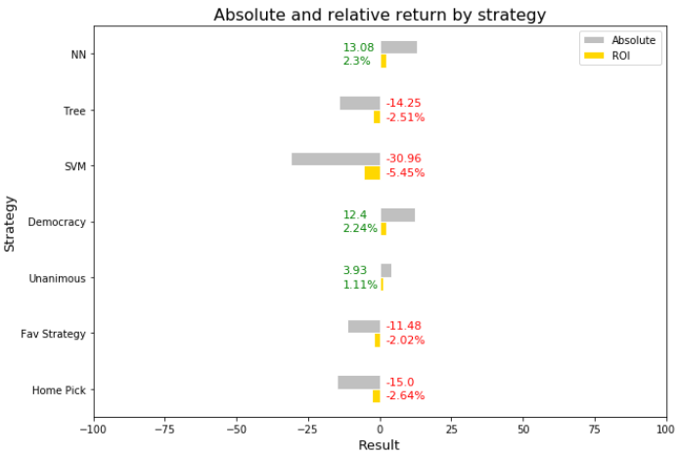
Returns
If you were to bet 1 unit on every model prediction in the test set¹
Model | Accuracy
Neural Network | 53.52%
Decision Tree | 50.53%
SVM | 52.46%
Democracy | 55.52%
Unanimous | 60.34%
Favorite | 53.17%
Home Team | 49.47%
Note that the models are neither designed nor intended to take advantage of discrepancies in the estimated and for betting available odds

Slide 15
2018/19
Accuracy in the current season – does it work in practice?
Gameday
Accuracy in % | 1 | 2 | 3 | 4 | 5 | 6 | 7 | 8 | 9 | 10 | 11 | 12 | 13 | 14 | 15 | 16 | 17 | 18 | Total
NN | 57 | 43 | 71 | 43 | 57 | 38 | 43 | 43 | 29 | 29 | 29 | 57 | 43 | 57 | 71 | 43 | 57 | 71 | 48.8
Tree | 43 | 43 | 43 | 29 | 43 | 38 | 43 | 43 | 43 | 14 | 43 | 57 | 43 | 43 | 43 | 43 | 86 | 71 | 44.9
SVM | 43 | 14 | 71 | 29 | 57 | 38 | 43 | 29 | 29 | 43 | 57 | 57 | 43 | 29 | 71 | 29 | 71 | 57 | 44.9
Democracy | 50 | 33 | 67 | 33 | 57 | 38 | 43 | 33 | 29 | 33 | 33 | 57 | 43 | 33 | 71 | 29 | 83 | 71 | 46.6
Unanimous | 67 | 25 | 100 | 50 | 60 | 33 | 40 | 40 | 40 | 50 | 67 | 75 | 50 | 67 | 100 | 50 | 80 | 100 | 59.1
Favorite | 43 | 43 | 43 | 43 | 57 | 62 | 29 | 43 | 57 | 71 | 29 | 57 | 43 | 43 | 43 | 43 | 86 | 100 | 51.9
Home | 71 | 14 | 71 | 29 | 57 | 62 | 43 | 14 | 29 | 29 | 71 | 43 | 43 | 57 | 57 | 29 | 43 | 29 | 44.1
NN vs. Naive
Model / Method
All approaches lead to volatile results
NN tends to be not worse than ‘naive‘
11 8
Since not every gameday has the same number of games due to inclusion restrictions (see slide 4), the total may deviate from the average of all gamedays.

Slide 16
Summary
Results:
There is some predictability in the data
The Neural Network works best, but is not a great predictor
Use case recommendation:
‘Naive’ approaches do just fine
!
Code:
https://github.com/FlorianParche/ubiquitous-octo-winner/tree/master/Predicting%20the%20Bundesliga%20with%20ML

